Slide 1
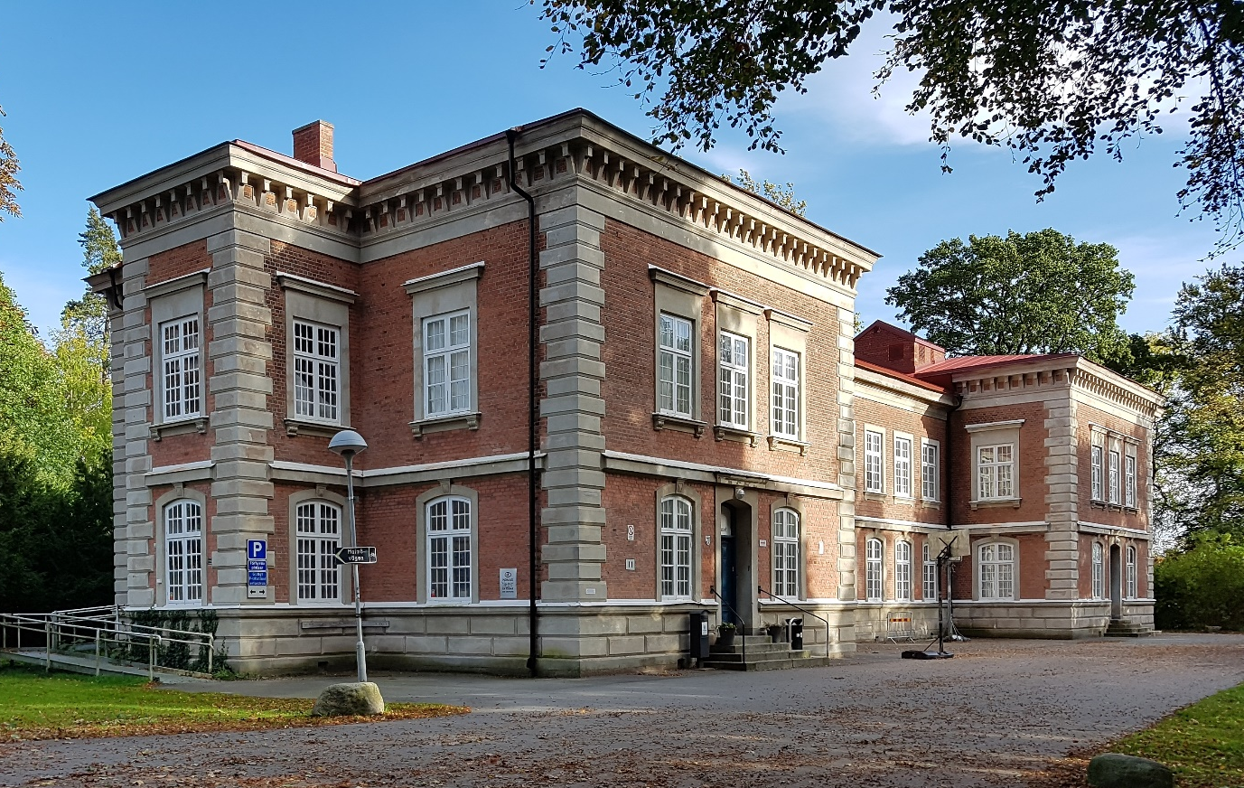
ICT
Czech Republic
Swedish Team

Slide 2
From NTI - Lund
Carin , Niclas
Hebun
Ludwig
Oscar

Slide 3
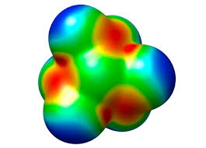
Agenda
Alfred Nobel (Niclas)
Periodic table (Hebun)
Balancing chemical equations (Oscar)
Stoichiometry (Ludwig)
Quiz (Ludwig)

Slide 4
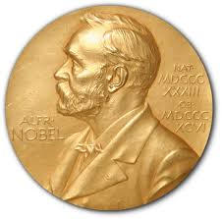
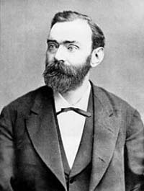
Alfred Nobel 1833-1896
Famous For: Invention of dynamite,
establishment of Nobel Prize
As the inventor of the dynamite, Alfred Nobel is seen as a chemist, innovator, engineer, and arms manufacturer.
Alfred Nobel (1833–1896)

Slide 5
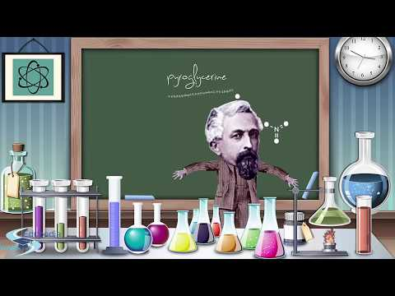
Alfred Nobel 1833-1896
Alfred Nobel (1833–1896)
Biography of Alfred Nobel | Dynamite Inventor | Nobel Prize |

Slide 6
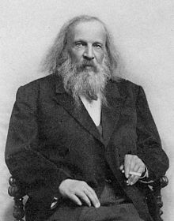
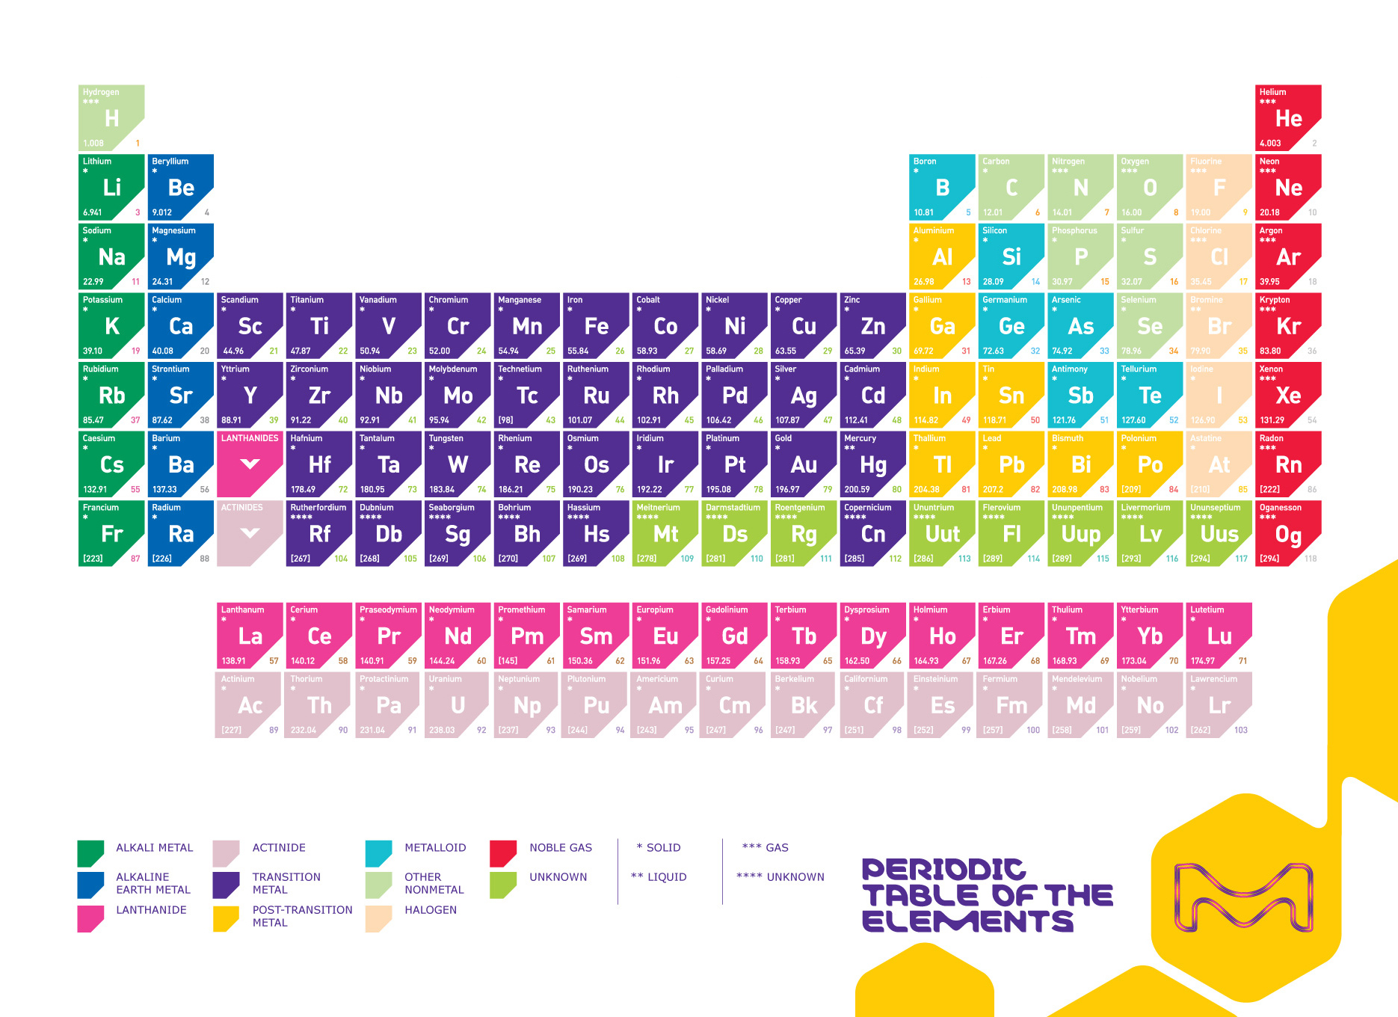
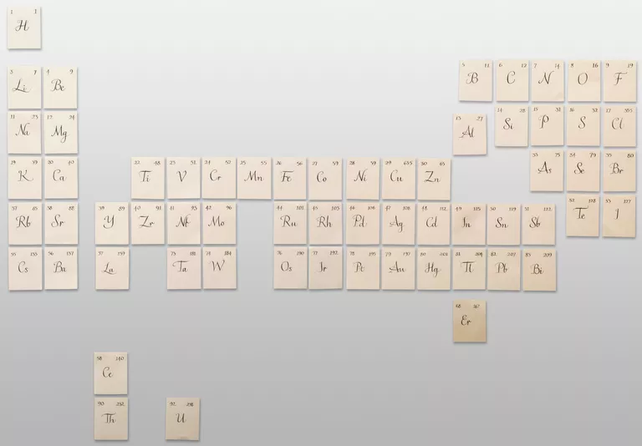
Who invented the periodic table?
exercise
Questions:
What period and group does gold belong to?
How many units does water weigh.
which group does the alkali metals belong to?

Slide 7
Balancing chemical equations
The app

Slide 8
Select Difficulty

Slide 9
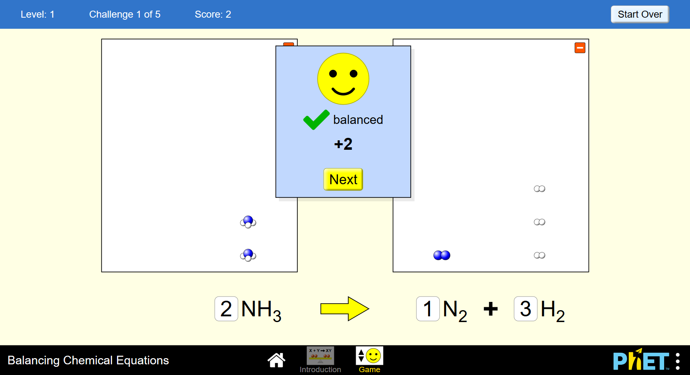
Select the correct amount of atoms on both sides

Slide 10
Play a game
Download “Chemistry Game” on your phone

Slide 11
Quiz Time!
Kahoot!

Slide 12
THANK YOU!

